Slide 1
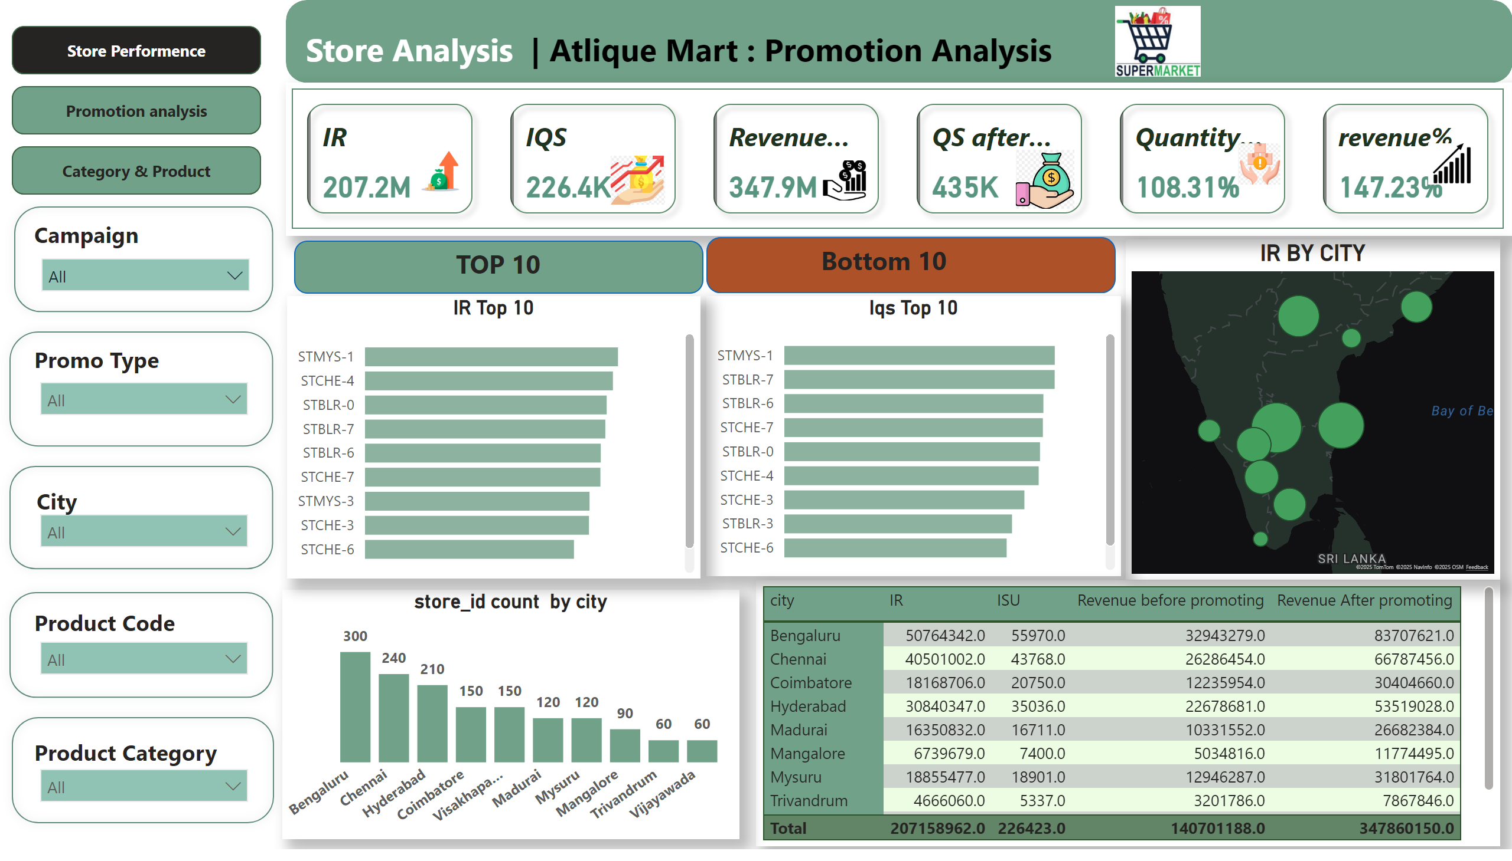
Store Performence
Notes:
shape
No alt text provided
shape
No alt text provided
shape
No alt text provided
shape
No alt text provided
shape
No alt text provided
shape
No alt text provided
shape
No alt text provided
slicer
No alt text provided
textbox
No alt text provided
slicer
No alt text provided
textbox
No alt text provided
slicer
No alt text provided
textbox
No alt text provided
slicer
No alt text provided
textbox
No alt text provided
textbox
No alt text provided
shape
No alt text provided
image
No alt text provided
textbox
No alt text provided
slicer
No alt text provided
cardVisual
No alt text provided
image
No alt text provided
image
No alt text provided
image
No alt text provided
image
No alt text provided
image
No alt text provided
image
No alt text provided
IR Top 10
No alt text provided
barChart
No alt text provided
Iqs Top 10
No alt text provided
store_id count by city
No alt text provided
barChart
No alt text provided
IR BY CITY
No alt text provided
tableEx
No alt text provided
shape
No alt text provided
shape
No alt text provided
actionButton
No alt text provided
textbox
No alt text provided
textbox
No alt text provided
actionButton
No alt text provided
actionButton
No alt text provided
pageNavigator
No alt text provided
actionButton
No alt text provided

Slide 2
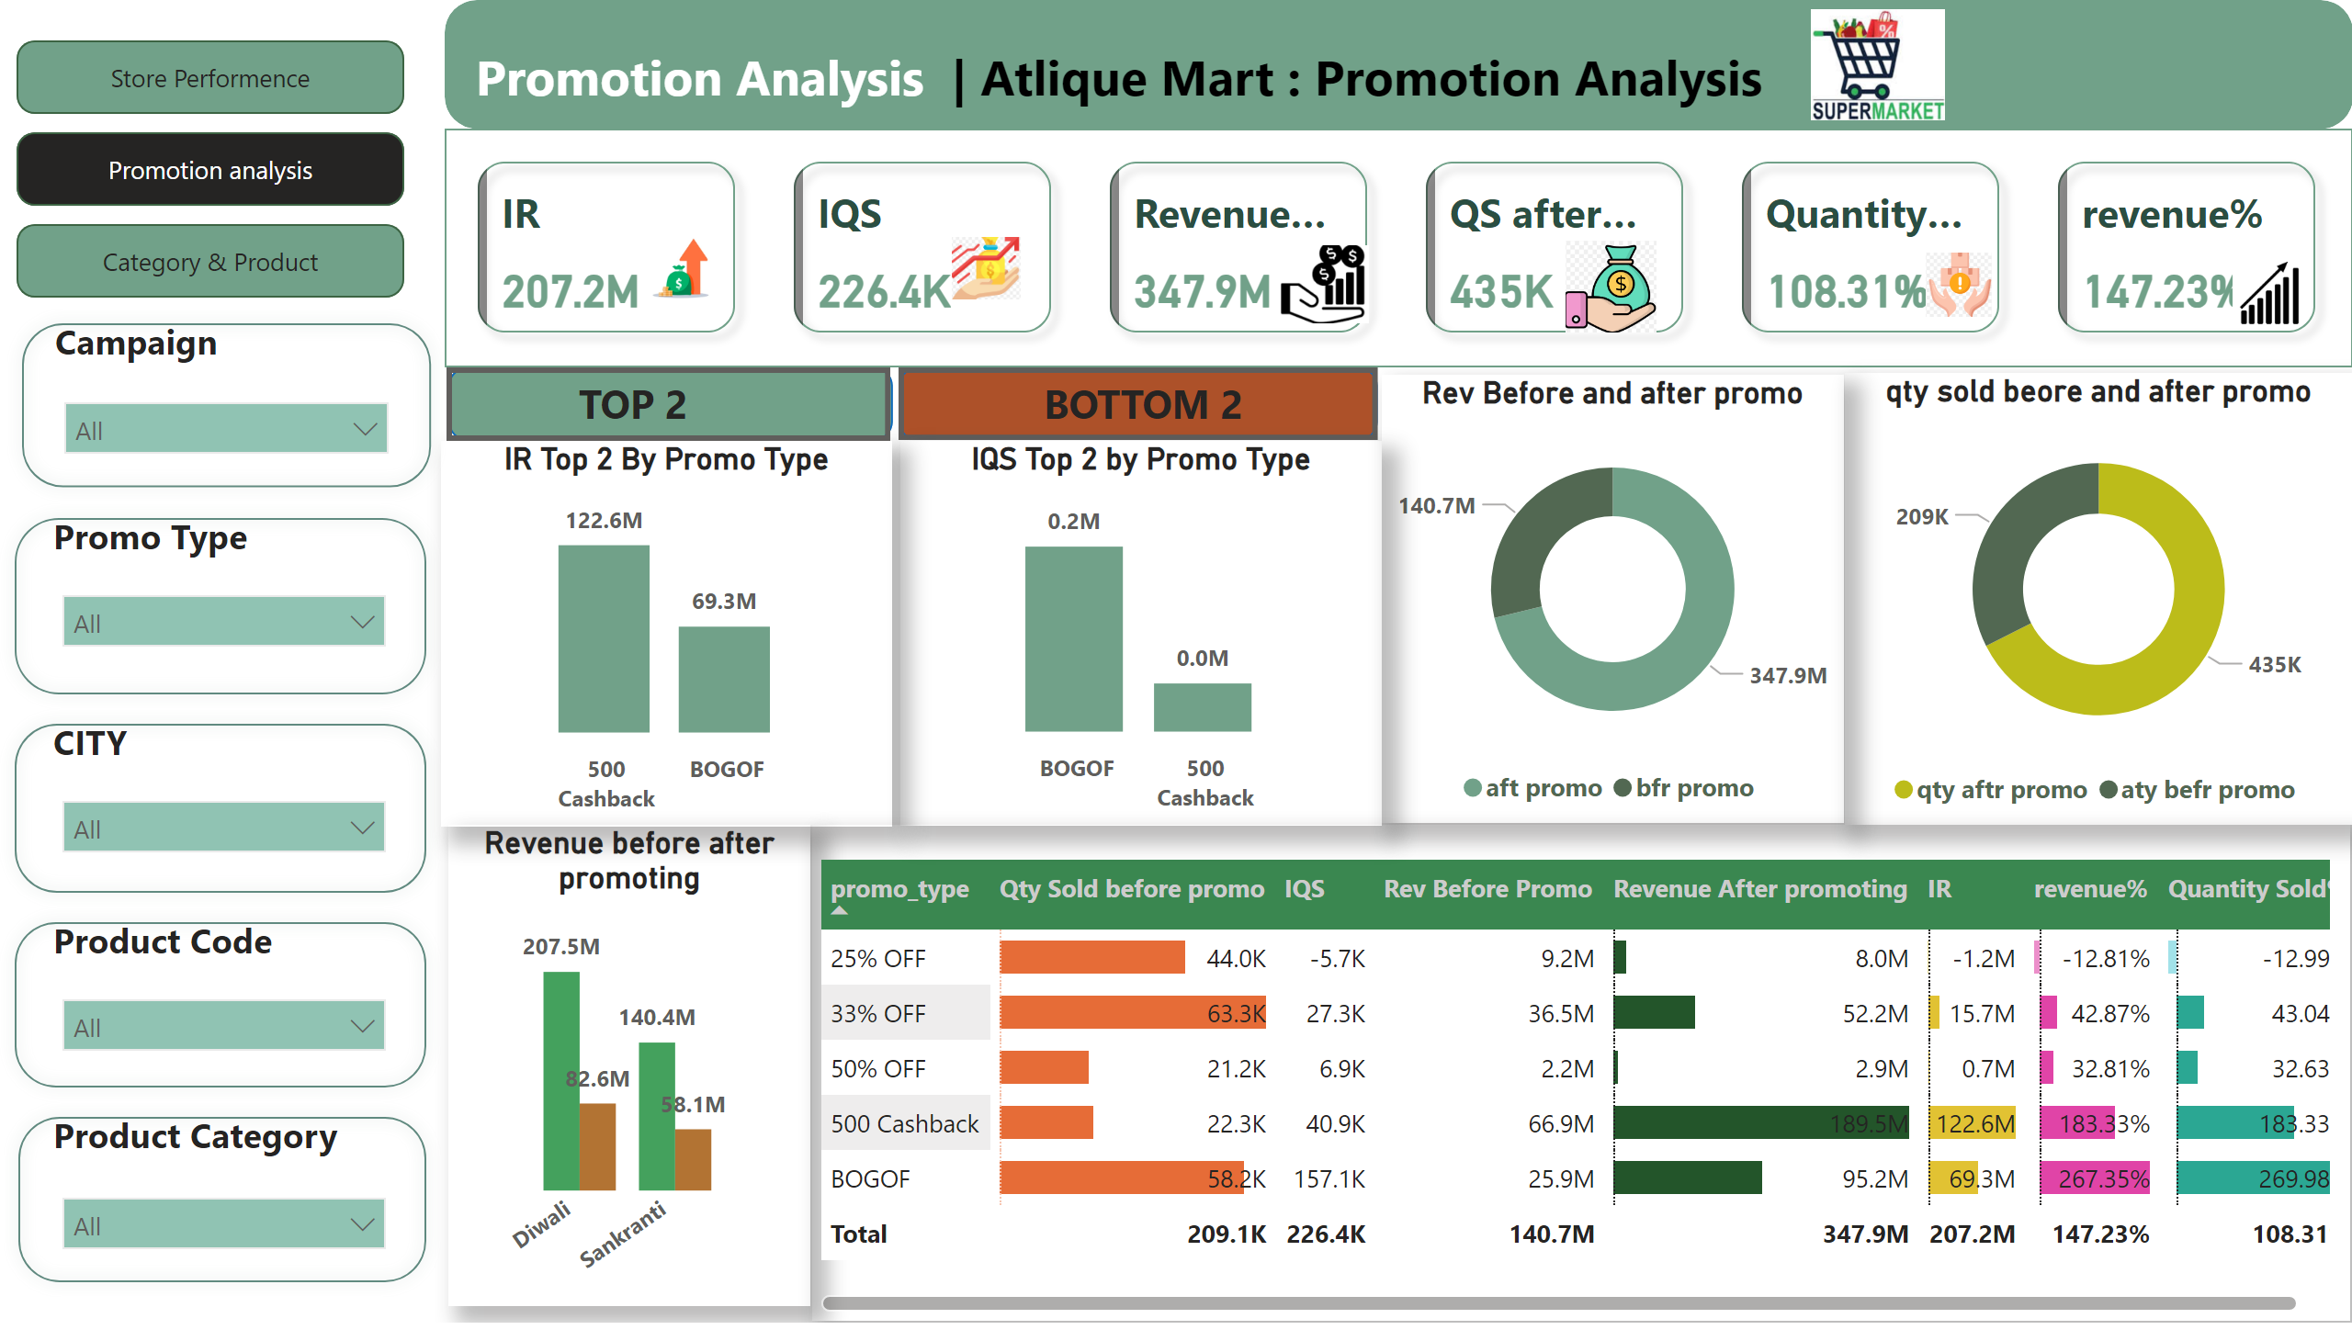
Promotion analysis
Notes:
shape
No alt text provided
shape
No alt text provided
shape
No alt text provided
shape
No alt text provided
shape
No alt text provided
shape
No alt text provided
shape
No alt text provided
slicer
No alt text provided
textbox
No alt text provided
slicer
No alt text provided
textbox
No alt text provided
slicer
No alt text provided
textbox
No alt text provided
slicer
No alt text provided
textbox
No alt text provided
textbox
No alt text provided
shape
No alt text provided
image
No alt text provided
textbox
No alt text provided
slicer
No alt text provided
cardVisual
No alt text provided
image
No alt text provided
image
No alt text provided
image
No alt text provided
image
No alt text provided
image
No alt text provided
image
No alt text provided
IR Top 2 By Promo Type
No alt text provided
columnChart
No alt text provided
Revenue before after promoting
No alt text provided
Rev Before and after promo
No alt text provided
qty sold beore and after promo
No alt text provided
pivotTable
No alt text provided
columnChart
No alt text provided
shape
No alt text provided
textbox
No alt text provided
shape
No alt text provided
textbox
No alt text provided
actionButton
No alt text provided
actionButton
No alt text provided
IQS Top 2 by Promo Type
No alt text provided
actionButton
No alt text provided
pageNavigator
No alt text provided
actionButton
No alt text provided

Slide 3
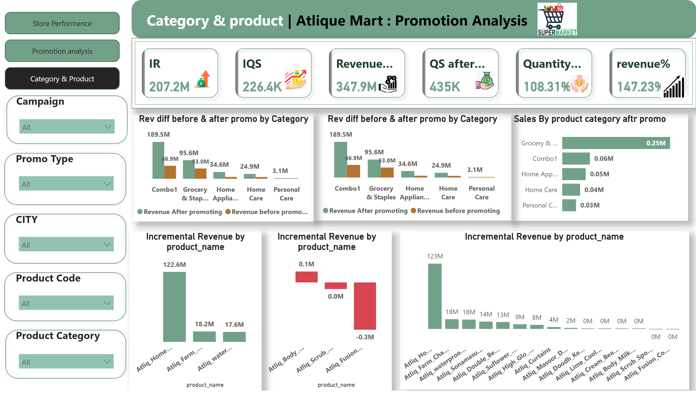
Category & Product
Notes:
shape
No alt text provided
shape
No alt text provided
shape
No alt text provided
Rev diff before & after promo by Category
No alt text provided
actionButton
No alt text provided
pageNavigator
No alt text provided
actionButton
No alt text provided
Sales By product category aftr promo
No alt text provided
columnChart
No alt text provided
columnChart
No alt text provided
columnChart
No alt text provided
Rev diff before & after promo by Category
No alt text provided
image
No alt text provided
image
No alt text provided
image
No alt text provided
image
No alt text provided
image
No alt text provided
image
No alt text provided
cardVisual
No alt text provided
slicer
No alt text provided
textbox
No alt text provided
image
No alt text provided
shape
No alt text provided
textbox
No alt text provided
textbox
No alt text provided
slicer
No alt text provided
textbox
No alt text provided
slicer
No alt text provided
textbox
No alt text provided
slicer
No alt text provided
textbox
No alt text provided
slicer
No alt text provided
shape
No alt text provided
shape
No alt text provided
shape
No alt text provided
shape
No alt text provided

